Slide 1
TravelYaari
Full-Stack Project
Submitted to – Mr. Pankaj Kapoor
World is a book and those who do not travel read only a page.”
~ Saint Augustine.

Slide 2
Submitted By-
Sarvesh Kumar Sharma-181500625
Satyam Kumar Jha-181500627
Sachi Tripathi-181500598

Slide 3
INTRODUCTION
This work deals with the development of web application for a travelling website Travelyaari. This application is developed for knowledge purpose allowing the user to choose the location he or she wants to travel and gather information about that place beforehand.
It is a simple, knowledgeable website.
User can search and book the desirable destination.
Data about the places is collected from different sources .
This application makes use of HTML, Java Script, CSS.
Frameworks such as Bootstrap and jQuery are also used.

Slide 4
Objective
The main objective of the project is to create a website named “TRAVELYAARI” using front-end technologies to continuously provide enjoyable quality excursions/trips on time and on budget.

Slide 5
FEATURES
The website designed is interactive and user friendly.
Simple and easy to play
Easy to modify

Slide 6
TECHNOLOGIES USED
Front-end Design:
HTML
CSS
Bootstrap
Client-side validation:
JavaScript
jQuery

Slide 7
SCOPE
The project that has been developed is a front end of a travel booking site.
The aim of this project is to provide people of each type of taste in travelling with an interactive online platform .
This web application can be great for those who want all sorts of places according to their choice
If provided with back end as well, this project can be brilliant in this field.

Slide 8
PRODUCT FUNCTIONS
Helps the user to grab the information about various locations .
This website has a simple interface.
As soon as user loads the page, index page appears in front of him.
After signup/login he/she will be taken to home page .
Through the home page, the user can choose from all the six type of places.

Slide 9
CONTINUED…..
As the user navigates to any of the six categories, he or she can see various locations.
All the locations are provides with two buttons.
Read more button to see more information about the place.
Book Now button to contact for booking.
There are separate pages for setting, information related to team and a gallery

Slide 10
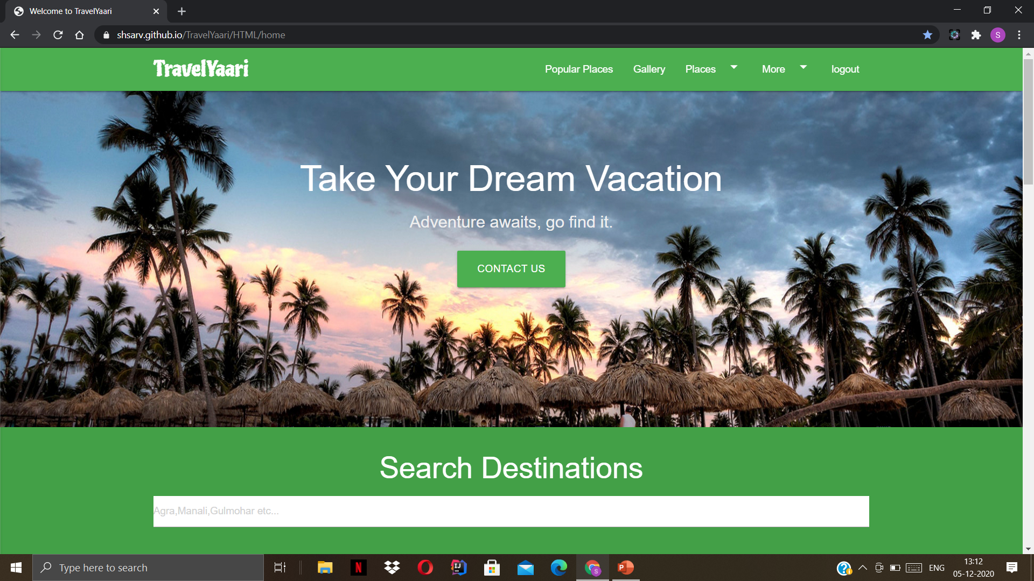
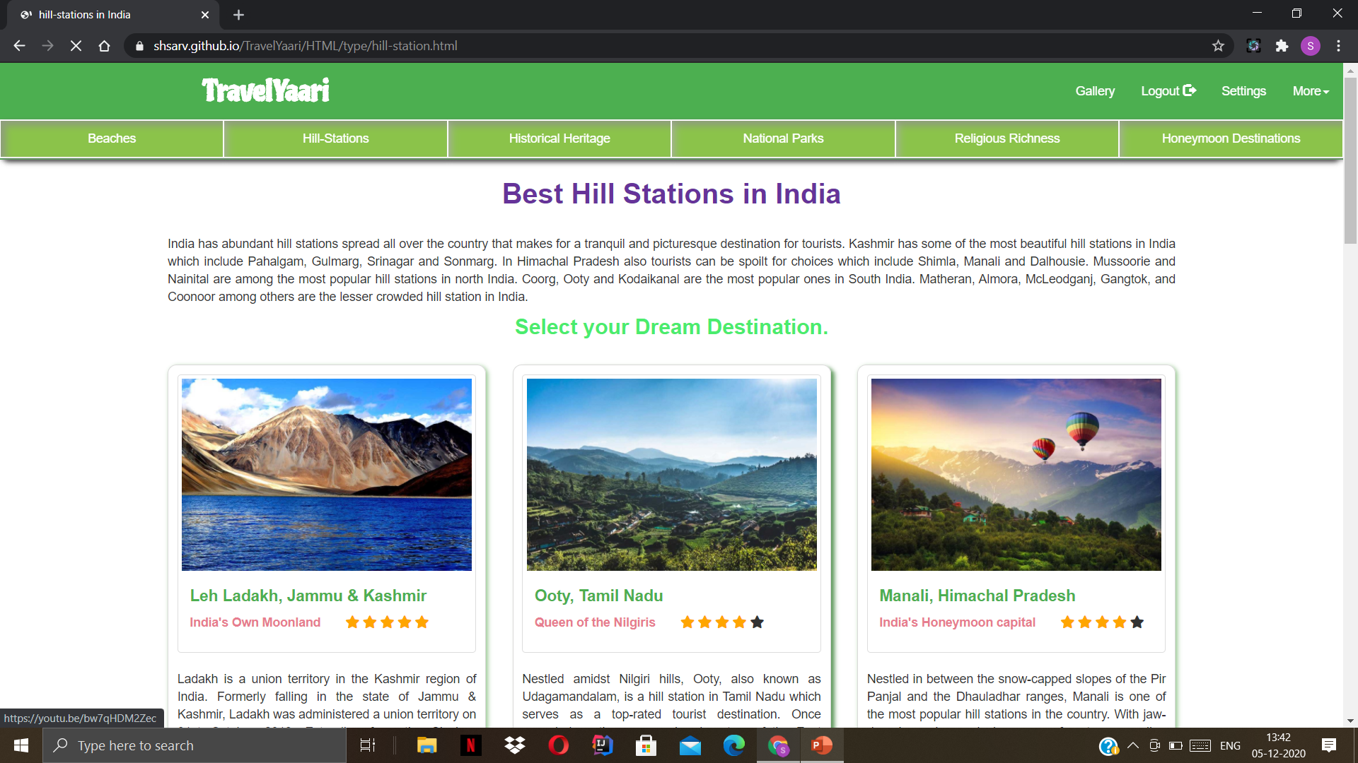
User Interfaces
Screenshots
Home Page
Types

Slide 11
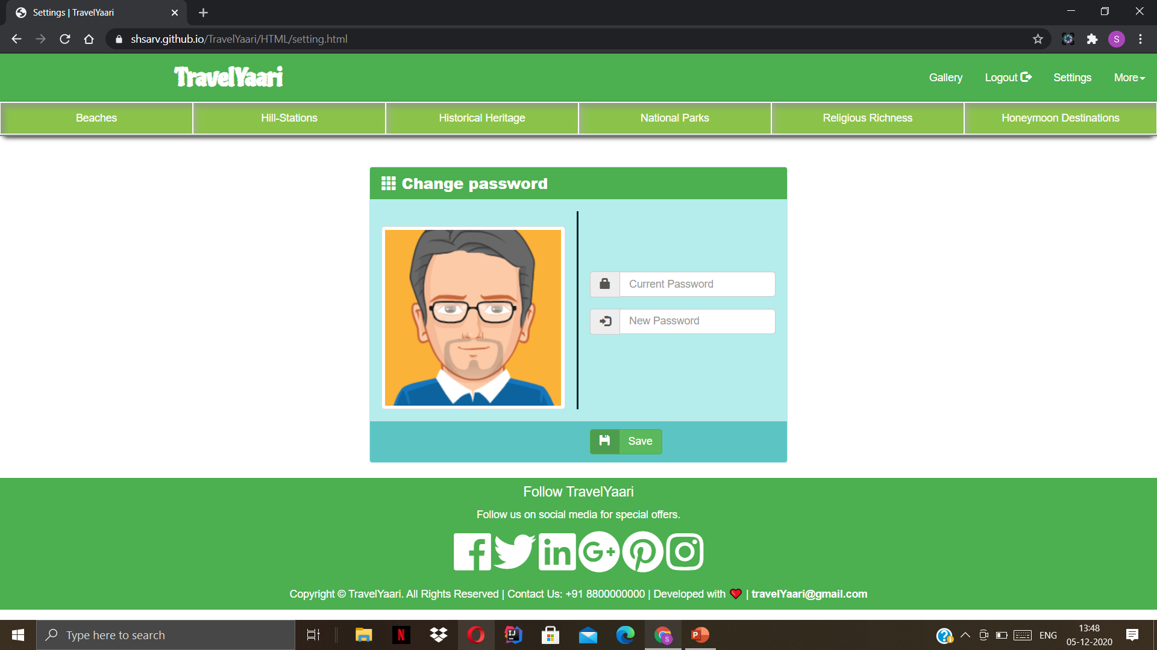
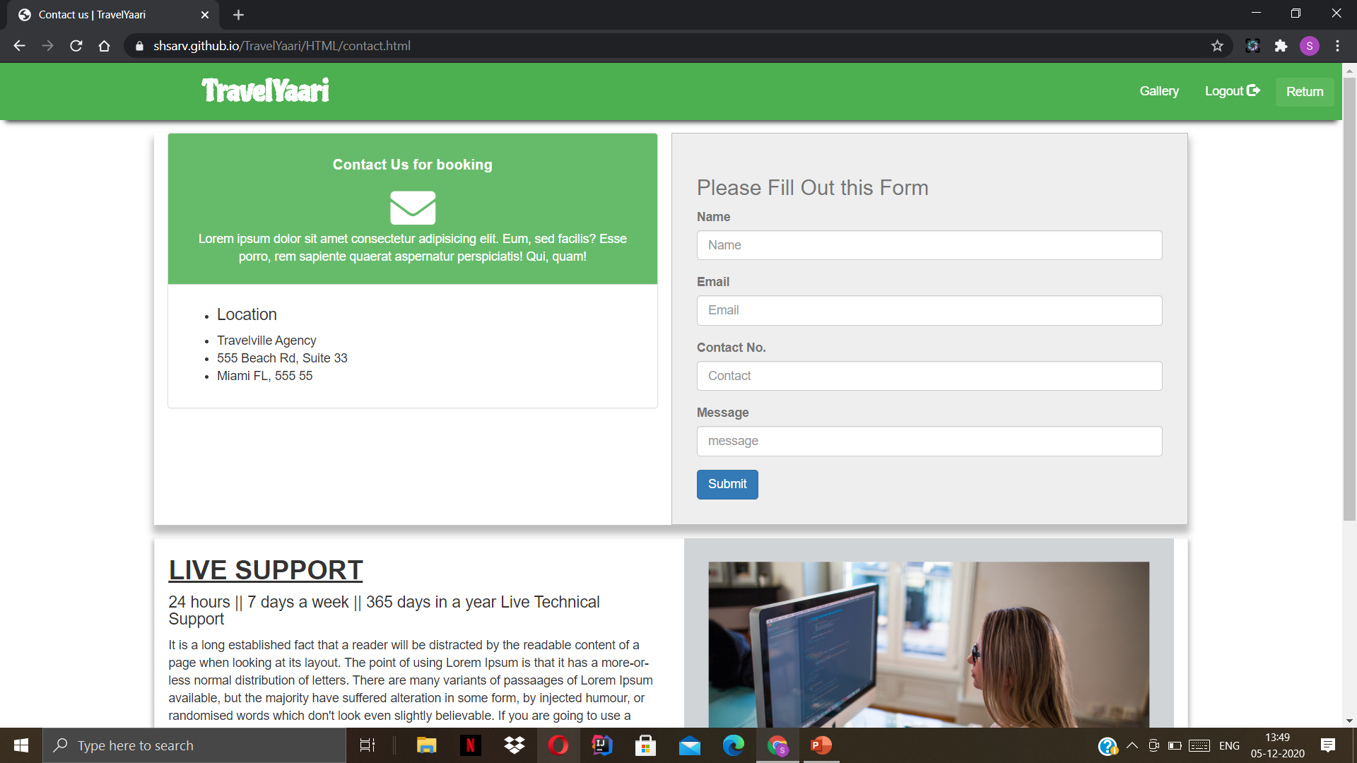
User Interfaces
Continued….
Settings Page
Contact Page

Slide 12
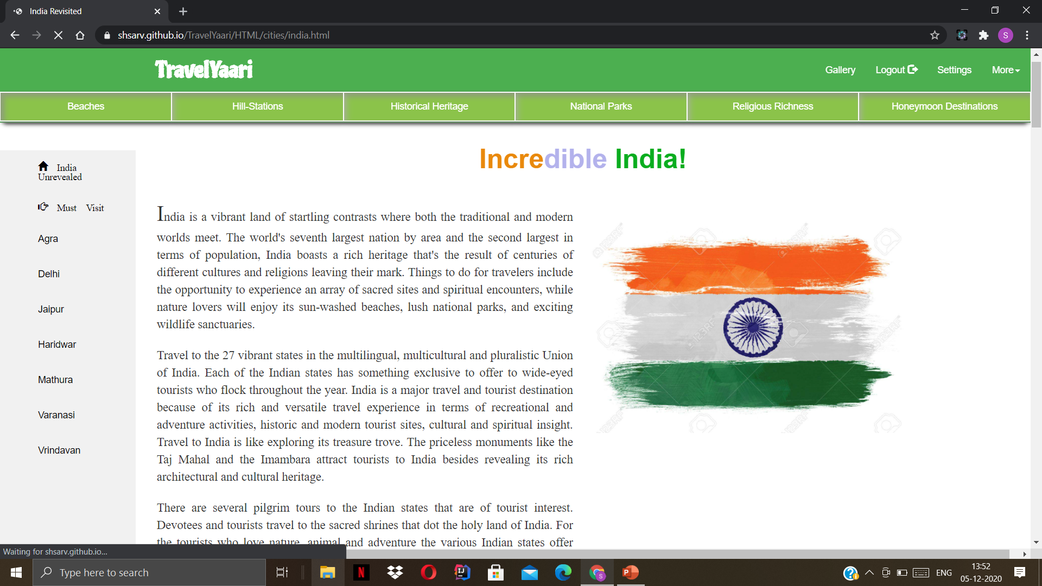
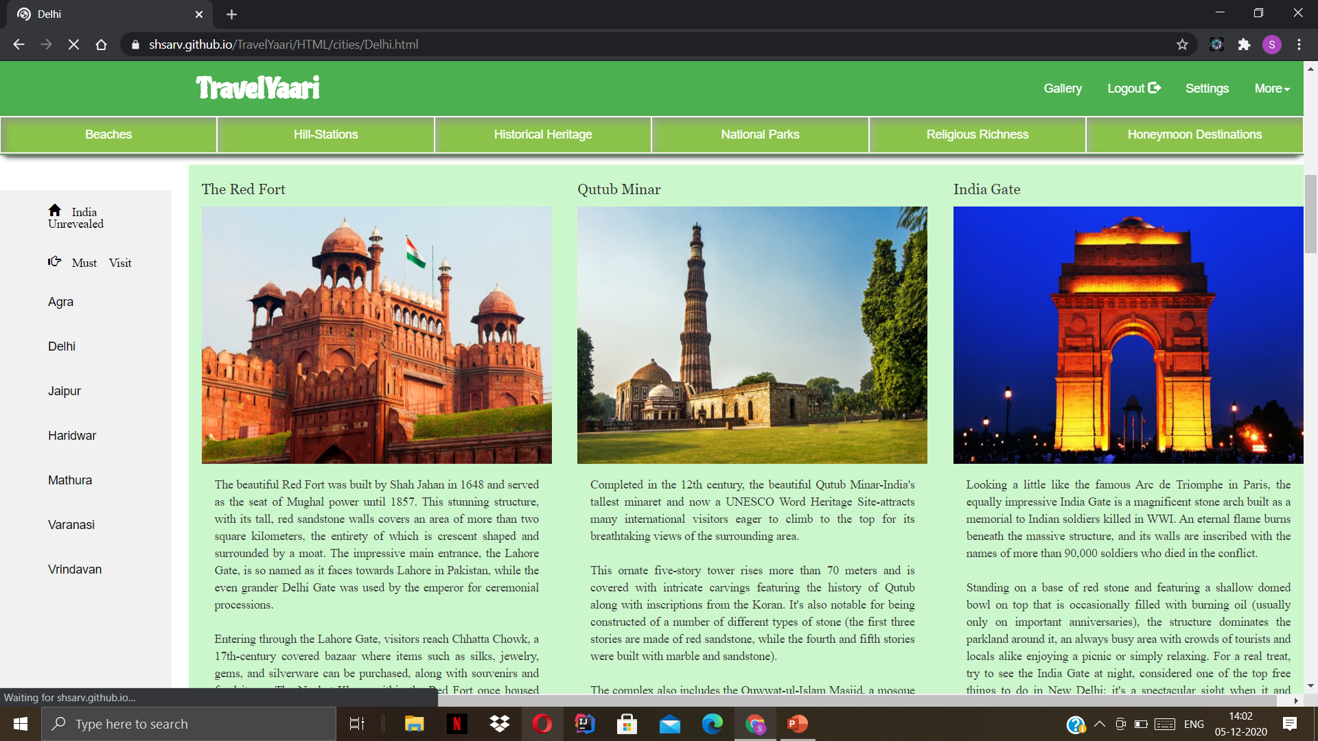
User Interfaces
Continued….
India Special Attractions Page
Special Cities

Slide 13
Conclusion And Future Work
Conclusion
Future Work
The main purpose of our project is to develop an application that offers new aspects of learning and improving knowledge in educational area.
Most of the available apps are entertainment-based, which mostly do not contribute to the academic enhancement of the students.
We have found that the difficult part was to gather all the information to be used as content and making the pages responsive and interactive from user point of view.
We are planning to keep managing the project and improving it based on user feedback.
We will add some more categories in our app.
We’ll try to make it more user friendly than it is now.
We’ll try to improve its quality.

Slide 14
Thank You.

